Slide 1
Welcome to
Our Sunday School
We’ll start at 9:07
visit OurSundaySchool.com for more about our class

Slide 2
Today’s class (pages 19-23)
Philippians 1:1-2

Slide 3
Philippians 1:1-2 (CSB)
Paul and Timothy, servants of Christ Jesus:
To all the saints in Christ Jesus who are in Philippi, including the overseers and deacons.
Grace to you and peace from God our Father and the Lord Jesus Christ.

Slide 4
Today’s class (pages 19-23)
Philippians 1:1-2

Slide 5
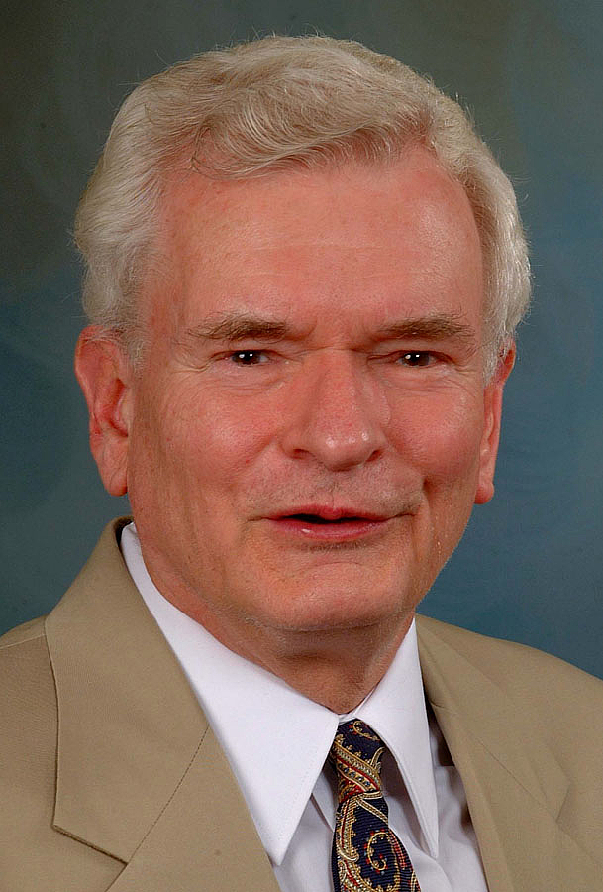
Dr. John Reumann
Christ Jesus provides the basis for their relation to God, “glue” for their connections with each other, the sphere for their life and endeavors together, and in Philippi the locale that distinguishes them from others as “Christ’s saints.”

Slide 6
Today’s class (pages 19-23)
Philippians 1:1-2

Slide 7
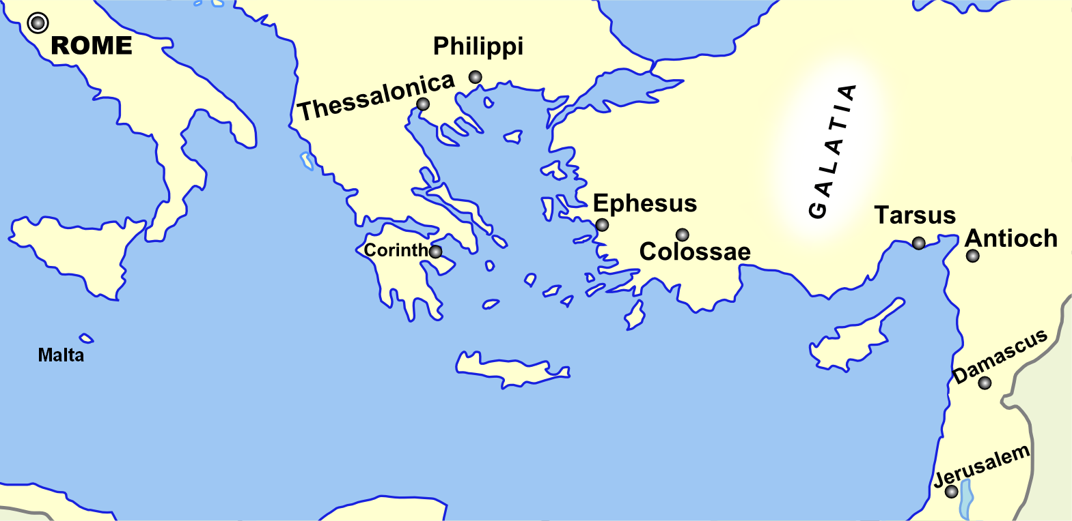
Monozigote. (2012). Broad Overview of Geography Relevant to Paul of Tarsus [Map]. Wikipedia.

Slide 8
Today’s class (pages 19-23)
Philippians 1:1-2

Slide 9
“saints… including…”
Option 1: (saints + overseers + deacons)
Option 2: (saints) + (overseers + deacons)
Either option: saints + overseers + deacons

Slide 10
Today’s class (pages 19-23)
Philippians 1:1-2

Slide 11
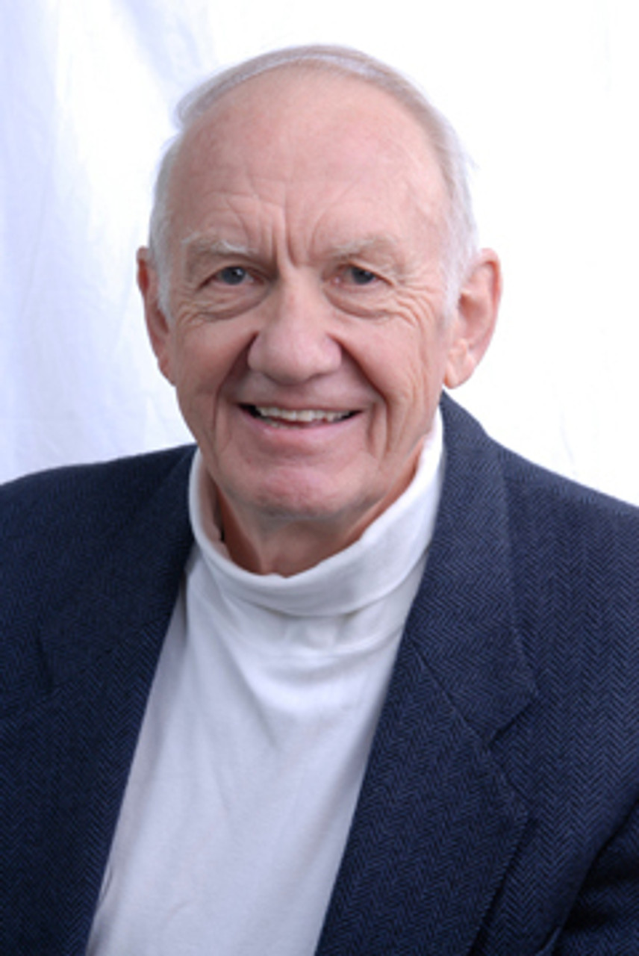
Dr. Gordon Fee
…a distinguishable part of the whole, but as part of the whole, not above or outside it

Slide 12
Today’s class (pages 19-23)
Philippians 1:1-2

Slide 13
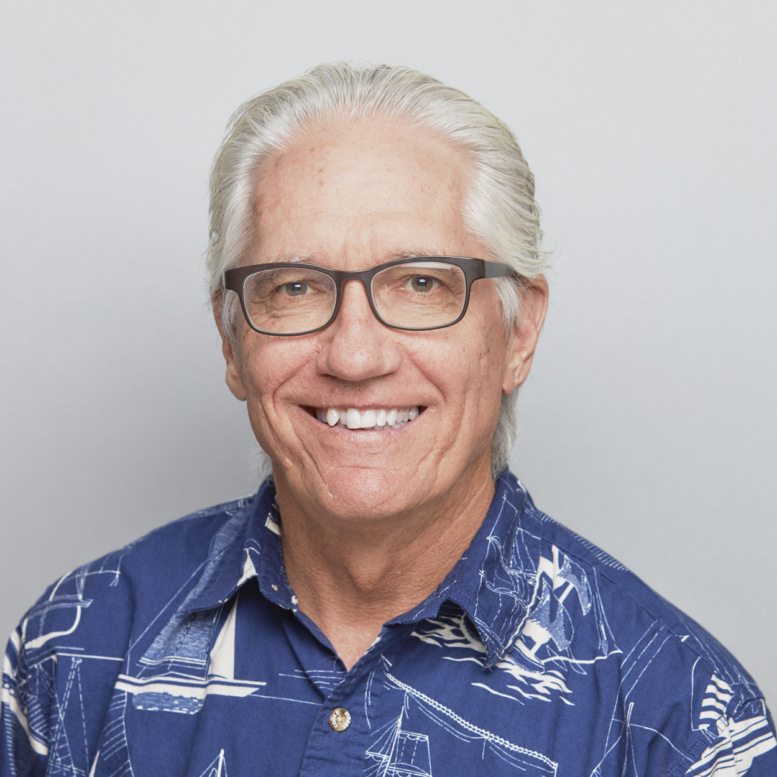
Dr. Joe Hellerman
The pacification of the known world by the Romans was known as the pax Romana/ Augusta. The ideology of universal peace and prosperity under Rome and her emperor…

Slide 14
Dr. Joe Hellerman
… was disseminated throughout the empire by coins bearing the terms Securitas, Salus, Concordia and Libertas (“security,” “safety,” “concord,” and “freedom”) (Reumann 67).

Slide 15
Today’s class (pages 19-23)
Philippians 1:1-2

Slide 16
Father
Son
is not
is
is
God
is not
is not
is
Spirit

Slide 17
Today’s class (pages 20-23)
Philippians 1:1-2

Slide 18
Prayer Time
Write down your prayer requests (on the Weekly Update or in the comments)
Lean in, engage, and pray for someone not with you
Go worship

